Slide 1


Building an AI
Slides
Code

Slide 2
AI,
mathematically
Part 1

Slide 3
Artificial Intelligence
Definition from Britannica:
Ability of a digital computer or computer-controlled robot to perform tasks commonly associated with intelligent beings.
Vague! But ok…
Why use an AI?
Information we give to the computer is always different (e.g. speech recognition: different accents and emotions) -> Intelligence to know how to understand it.
A lot of work to do by hand. AI can be trained, like a human!

Slide 4
An AI model
We want to know which number is in the image
input
output
Pixel 1
Pixel 2
…
Pixel 784
AI
P(0)
P(1)
…
P(9)
Pixel brightness

Slide 5
The neuron
Functional unit of AI. Like a neuron for our intelligence.
Previous layers determine the values ​​of the subsequent ones!
Intermediate layers
input
0.5
0.1
output
0.7
0.8
0.2
0.6
NB!
Not all AI works like this. This is just a classic and didactic model.
0.4
0.2
0.9
0.3

Slide 6
How are values decided?
N₁ = σ(w₁⋅n₁ + w₂⋅n₂ + ₃⋅n₃)
N₁ ≟ w₁⋅n₁ + w₂⋅n₂ + w₃⋅n₃
0.1
n₁
0.4
0.1
w₁ = 0.8
0.8
w₂= 2.3
= σ(0.8⋅0.1 + 2.3⋅0.6 – 0.3⋅0.3)
N₁
0.6
w₃ = –0.3
0
0.7
n₂
NB!
σ(x) = 1 .
1+e^{–x}
0.2
0.3
N₂
0.9
0.5
n₃
We do this for all neurons in one layer.
Then, we move on to the next one, until we reach the output

Slide 7
The cost function
We need a function that evaluates the accuracy of our AI so we can train it.
We call this function the cost function C = C(w₁, w₂, w₃, … , w_{n–1}, w_{n})
output
desired
0.8
0.3
(0.8 – 0.3)²
C( {w_{i}} ) = (0.8 – 0.3)² + (0.2 – 0.7)²
0.2
0.7
(0.2 – 0.7)²
Goal: Find the weights that minimize the cost function!

Slide 8
Training an AI
For artificial intelligence to be truly intelligent, it must know how to learn from its own mistakes!
As we saw, this is the same thing as minimizing the cost function → minimize the differences between the desired and the output
N₁ = σ(w₁⋅n₁ + w₂⋅n₂ + w₃⋅n₃)
0.1
n₁
0.8
output
To change a previous neuron, we need to compute the "opinion" of all other neurons of the layer before.
0.8
Manners:
Decrease the weights proportionally to the previous neurons
Decrease the previous neurons proportionally to the weights
But we can’t do this directly
2.3
0.6
n₂
desired
0.3
–0.3
0.3
n₃

Slide 9
Training an AI
For artificial intelligence to be truly intelligent, it must know how to learn from its own mistakes!
As we saw, this is the same thing as minimizing the cost function → minimize the differences between the desired and the output
N₁ = σ(w₁⋅n₁ + w₂⋅n₂ + w₃⋅n₃)
0.1
n₁
0.4
output
To change a previous neuron, we need to compute the "opinion" of all other neurons of the layer before.
The change that the previous neurons will want is the composition of the changes that the current ones (in this case, those of the output) suggested.
0.8
0.6
–2
n₂
desired
We proceed recursively, going back layer by layer to satisfy the wishes of the previous neurons!
0.2
0.7
–0.8
0.3
n₃

Slide 10
The following slides are extremely math-heavy, with a lot of index chasing. If you feel overwhelmed, don’t worry! We will only write with numbers what we have seen in the previous slides.
It is not really necessary for the coding part.

Slide 11
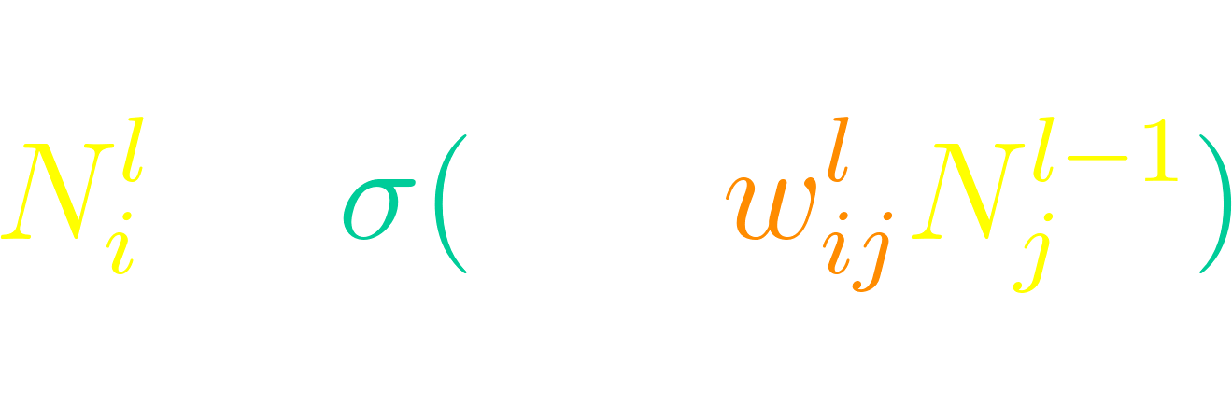
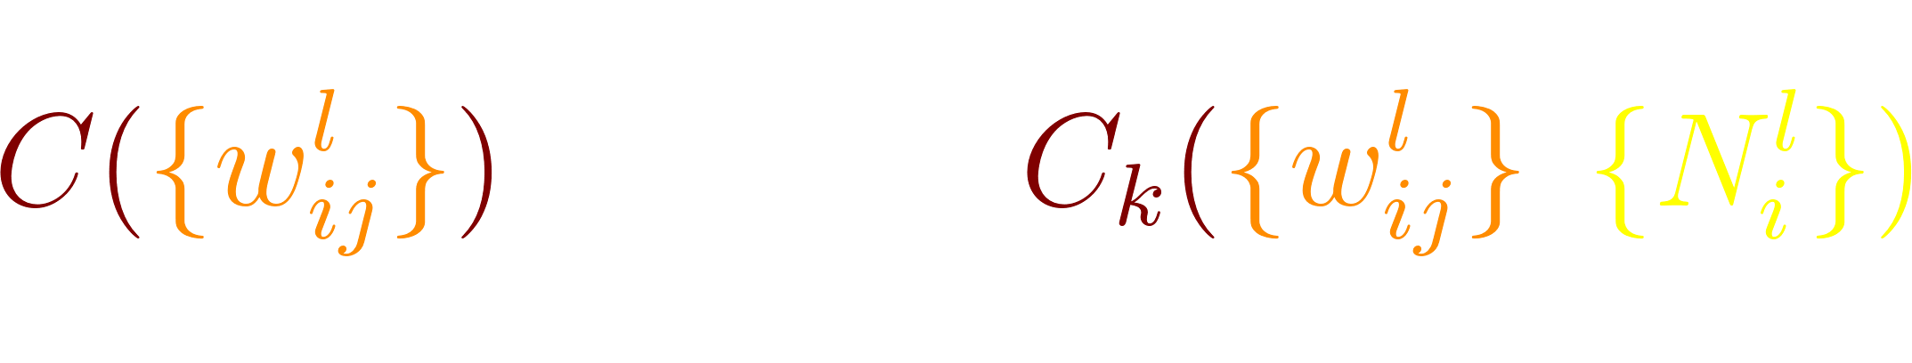


Training an AI: the calculus
We want to know the quickest path to minimize the cost function.
Opposite to the quickest path to maximize it → opposite to the gradient of the cost function!
N₁²
w³₄₁
N₄³
w³₄₂
N₂²
w³₄₃
NB!
Ideally, our training set = whole train data. However, that is costly, so we train the AI using random batches of smaller training sets
The total cost of our model is just the average of the cost of the inputs of the whole training set
Each set of inputs k yields a cost C_{k}
Each training set consists of n sets of inputs
N₃²
Goal: find so that we can set .
Because the gradient is linear, we need only care about C_{k}

Slide 12

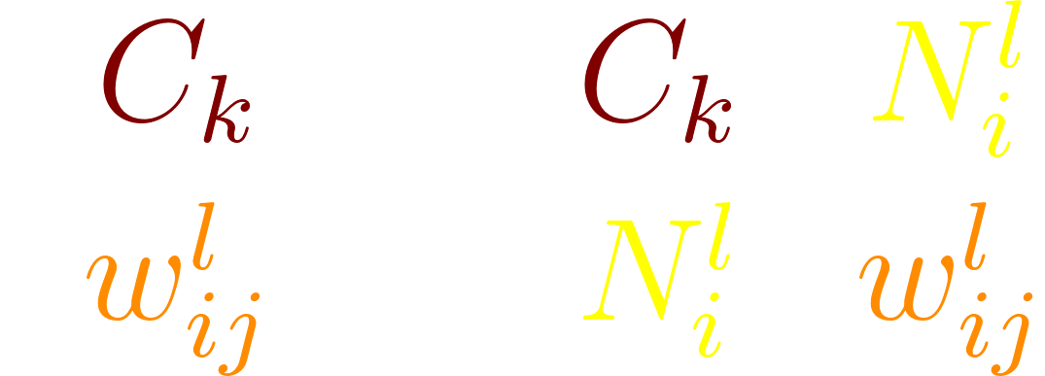

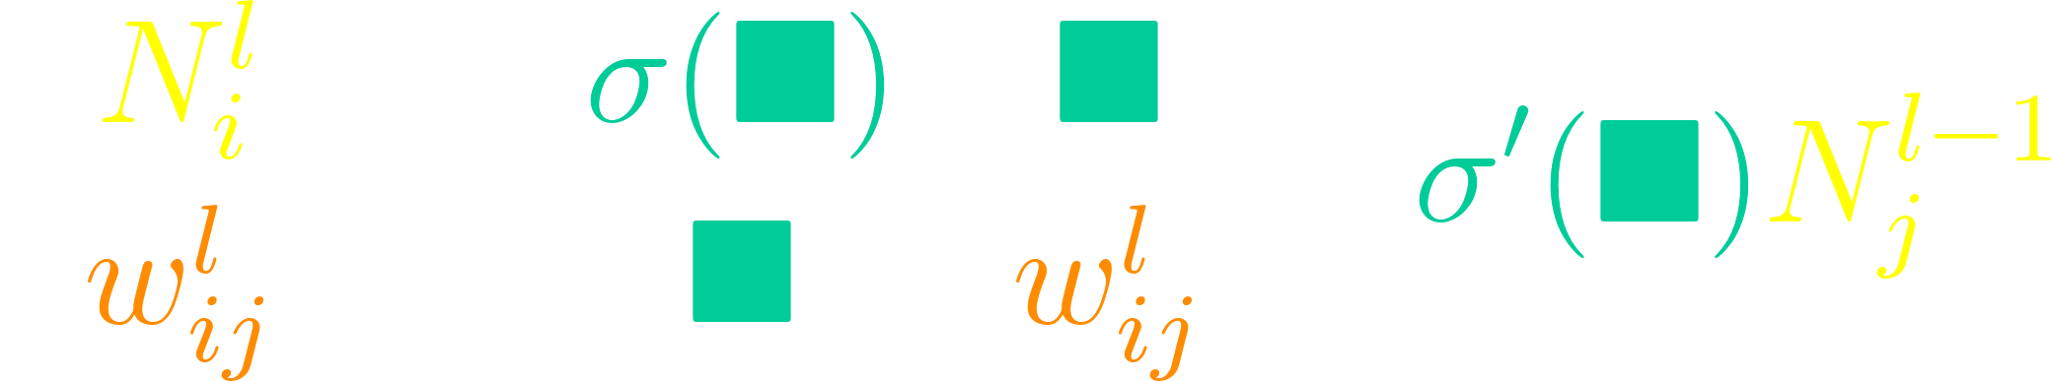
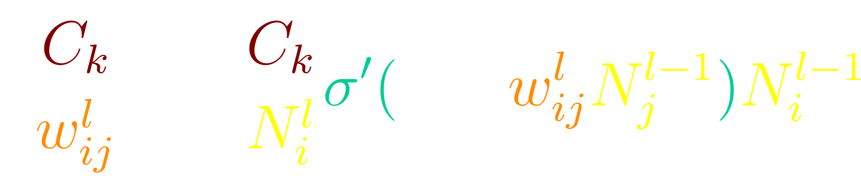
Training an AI: calculating the gradient
k
N₁²
w³₄₁
But
N₄³
w³₄₂
N₂²
Thus:
w³₄₃
N₃²
Now we need to find this bad boy; then we will be done!

Slide 13
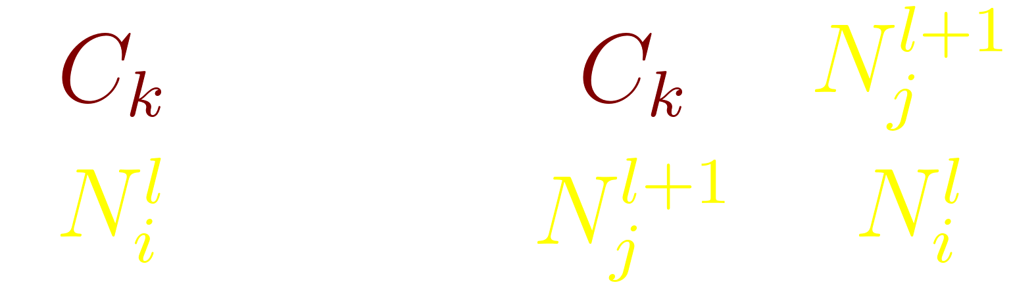

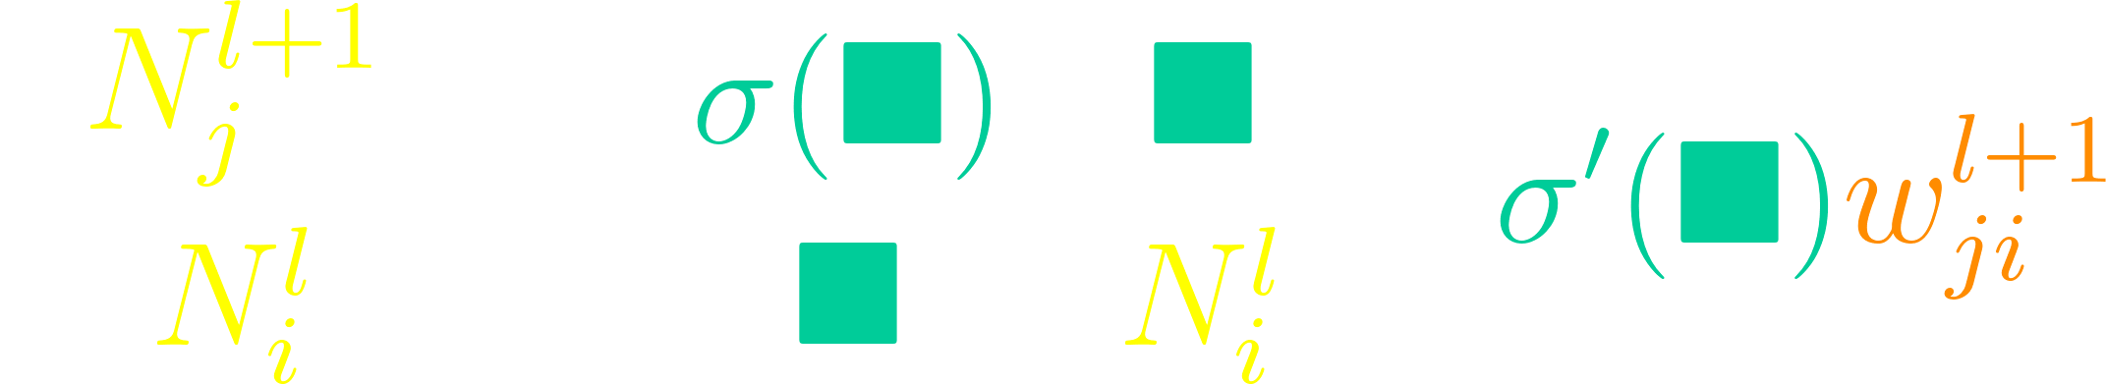
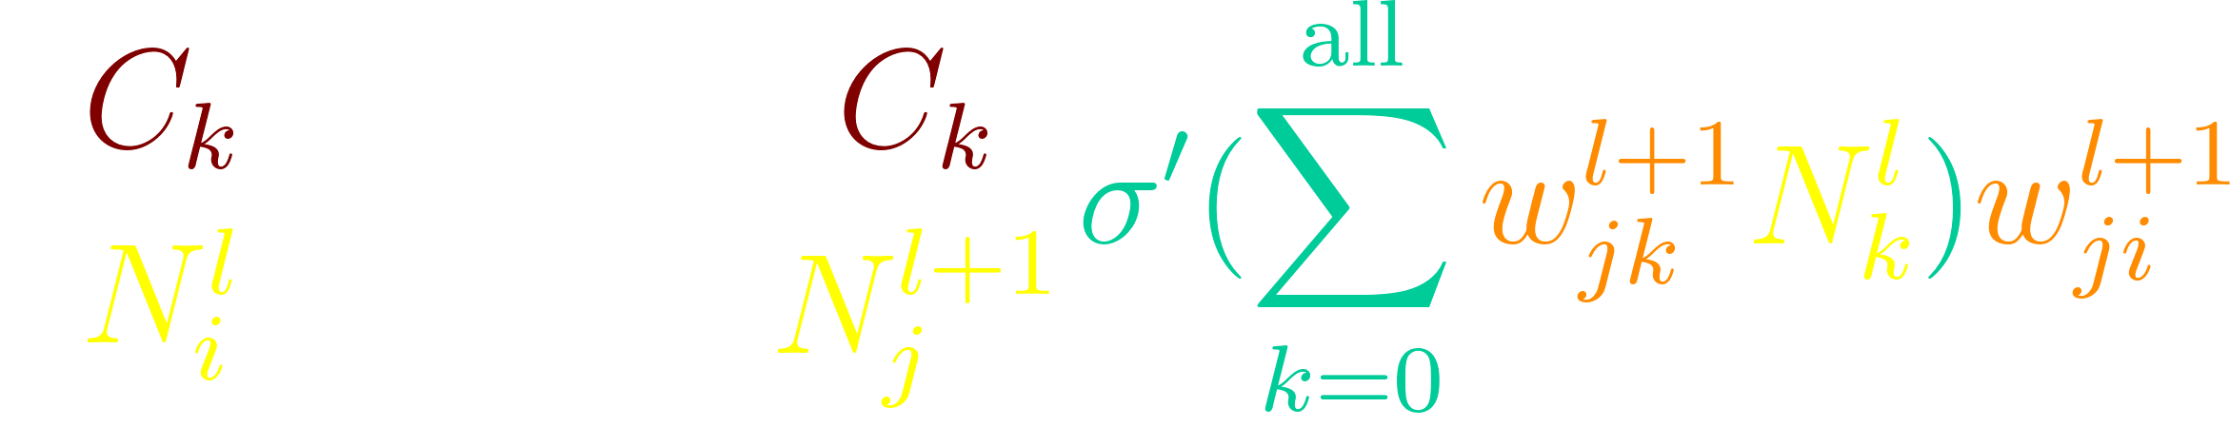
Training an AI: calculating the gradient
N₆⁴
But:
w⁴₆₄
N₄³
w⁴₇₄
N₇⁴
Thus:
w⁴₈₄
N₈⁴
It is a recursive formula!
We set as our base case.

Slide 14

A few remarks regarding the math
It can be written in a much better way in matrix form:
2. Because of that, it is highly parallelizable (i.e. the computer can theoretically do much of the multiplication and addition simultaneously) → GPUs are extremely useful!
3. Nevertheless, it remains quite processing-intensive (number of parameters can skyrocket!)
Luckily, we don’t really need to know all the math in order to use AI!

Slide 15
AI,
in practice
Part 2

Slide 16
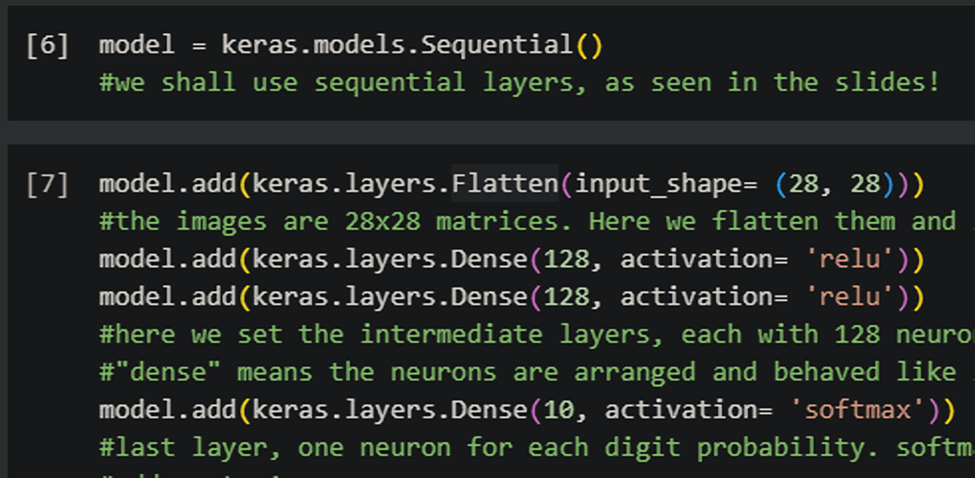
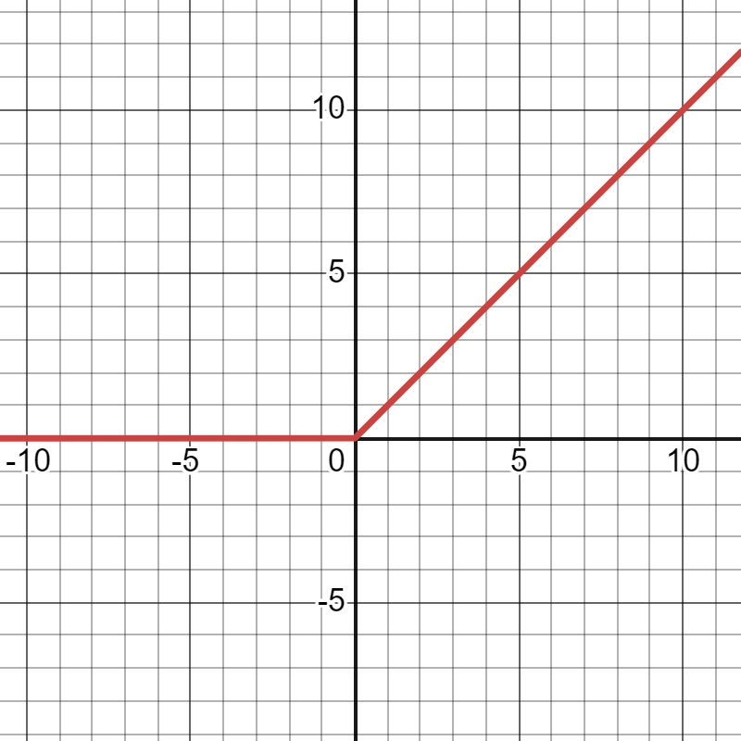
Building an AI model: the neurons
We shall use TensorFlow (Python library) with Keras (its API) to code our model
NB!
The weights are initialised randomly, and the values are empty (they only arise when we give inputs! The model is the weights)

Slide 17
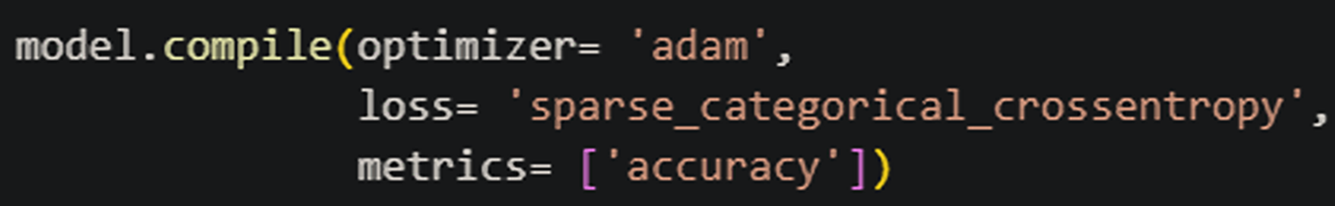
Building an AI model: the training settings
These settings will be taken into account when we actually train the model
This sets the backpropagation algorithm. “Adam” is a modified version of the gradient descent that has been shown.
This sets the cost function. Unlike the “sum of squares” we used, this is more appropriate to our kind of data (categorical variables)
NB!
The metric does not interfere with the training process. It is only shown to us!
This sets the metrics that will be shown to us. Of course, we are interested in the model’s accuracy!

Slide 18
Building an AI model: organizing the data
Our amount of data is huge, so we use fractions of it
Data
We divide our training set into random batches. Our model is updated after each batch.
Testing
Training
Data
Data
Labels
Labels
Each data point has its “label”, an answer key
The AI (or the researcher) checks the model’s prediction for the labels against the true labels in order to train (or tune) the model
NB!
We need to strike a balance between training time, model size/complexity, and accuracy; all while avoiding overfitting!
A run through the entire training dataset is called an epoch. We can have many of them until the model is finished!

Slide 19
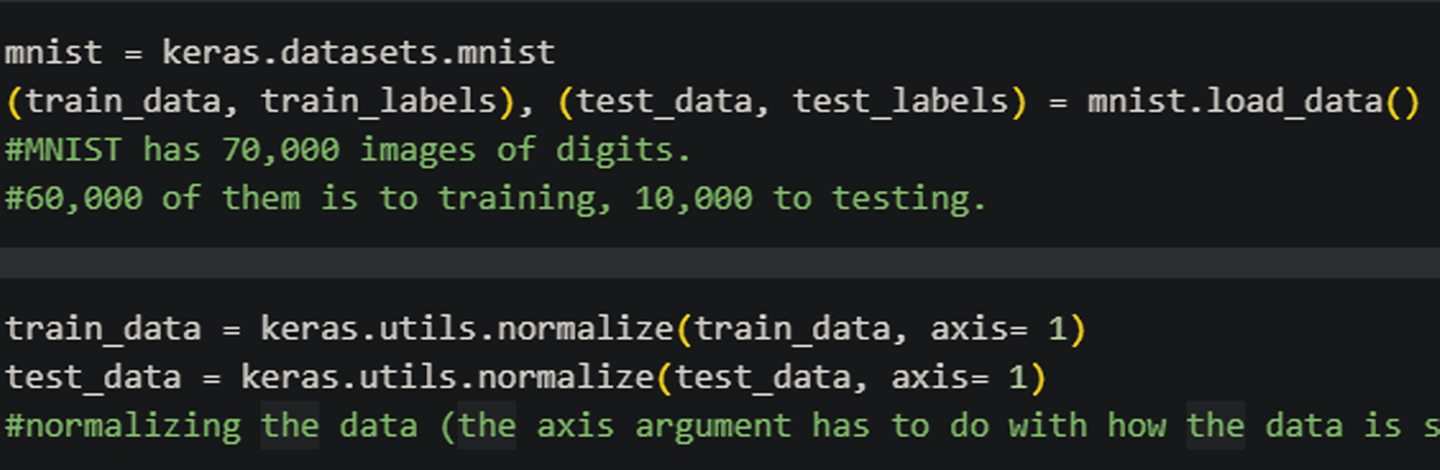
Building an AI model: getting the data
We need to format our data in order to have the model use it
Luckily, Keras already has the MNIST dataset formatted!
The only thing we need to do is to normalize the pixel brightness values so that they are consistent

Slide 20
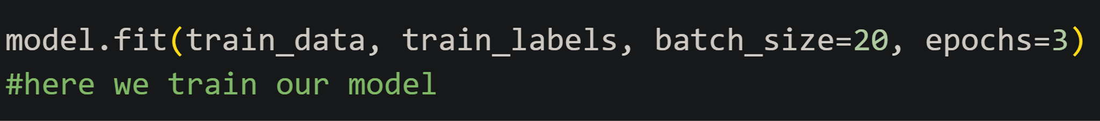
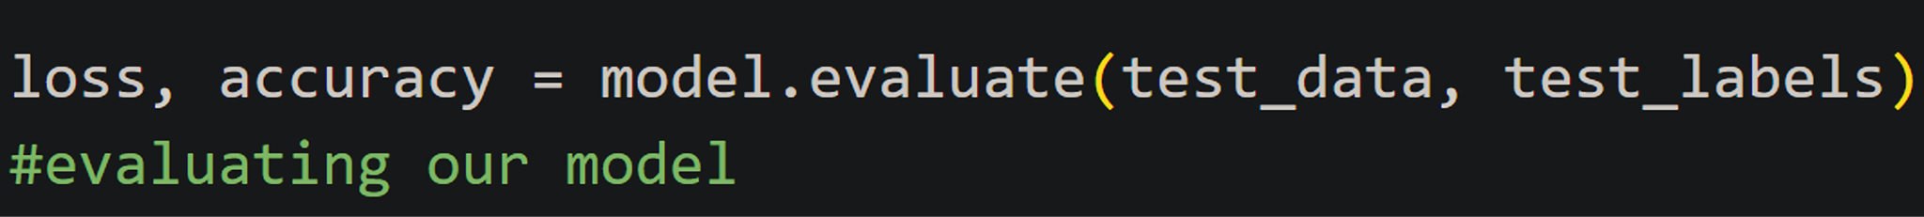
Building an AI model: training the model!
(quite the self-explanatory methods)
The rest of the code is housekeeping and seeing which images were poorly predicted

Slide 21
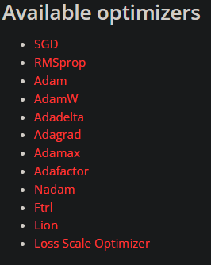
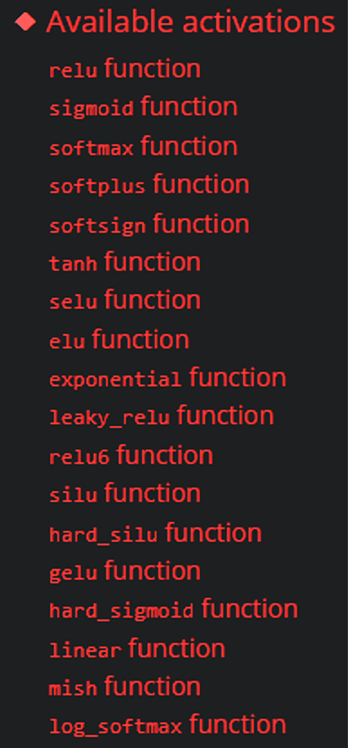
Your turn!
Modify the code to achieve the best possible accuracy! tinyurl.com/sigmaMNIST
What happens when you change the number of layers? How about the number of neurons? And the normalizing function?
How about changing the optimizer?
Can changes in batch size effect changes in the resulting model? Does a model that went through more epochs perform better?
BEWARE: is training time taking too long? How about evaluation time?
Which images is the model getting wrong? Do different models have different wrong guesses?
Would you have guessed better than the model?
Some may not work with our model :/

Slide 22
Same AI,
different data
Extra section

Slide 23
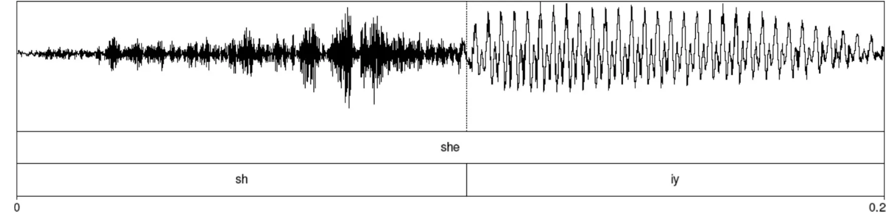
How we speak
The building blocks of words are phonemes (little sound pieces)
Basic idea: identify the phonemes in an audio file → identify the words based on the phonemes
/ʃ/
/i/
/ˈʃi/ = “she”!

Slide 24
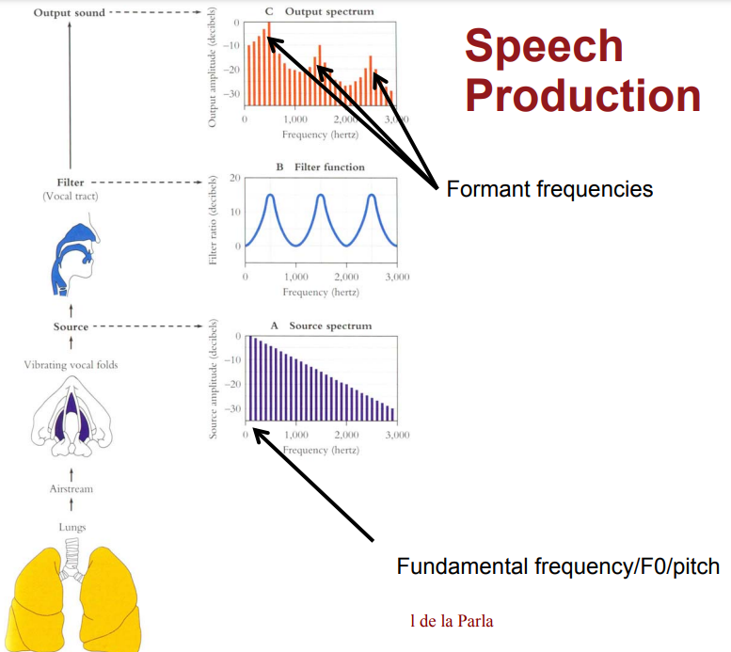
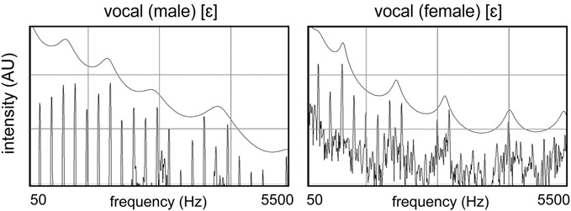
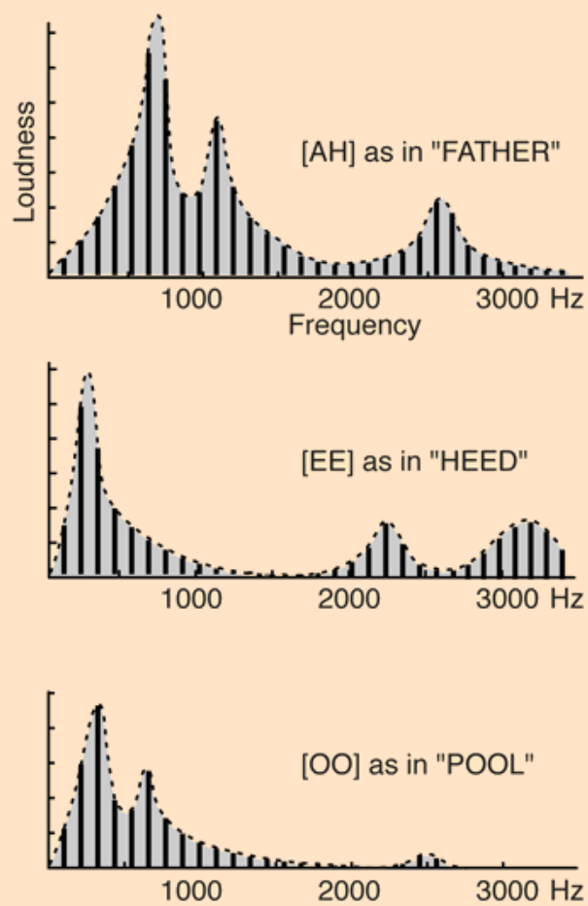

Phonemes, mathematically
Phonemes have their own distinct frequency composition
Key idea: we recognize the features of the phonemes in our audio using AI!

Slide 25



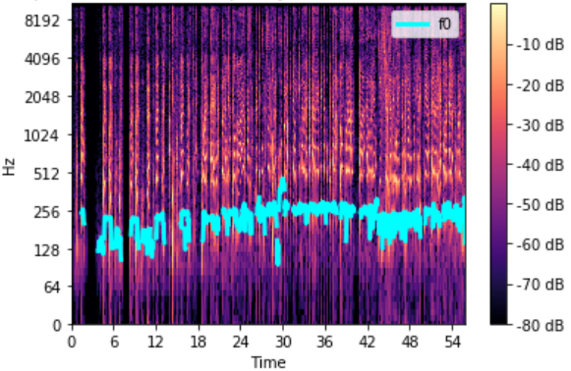
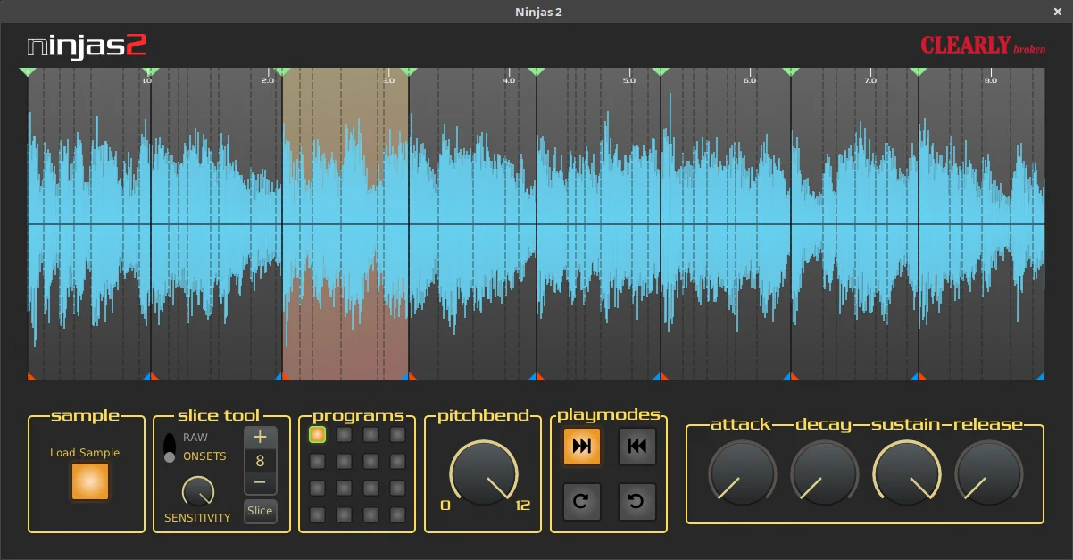
Extracting the audio
Noise reduction
recording
filtering
Subjective intensity correction
Removal of fundamental frequency
slicing
Extract information into parameters
Frequencies
How they rise
How they decay

Slide 26
Processing the audio
We use AI to determine the probability a specific phonem has been detected
audio
parameters
phonem
probabilities
0.5
0.1
0.7
0.8
0.2
0.6
NB!
Models also view previous phonemes to determine the total probability
0.4
0.2
0.9
0.3

Slide 27
Processing the audio
We can use AI to determine the probability a specific word has been detected
phonem probabilities
word
probabilities
0.5
0.1
0.8
0.6
0.2
0.6
NB!
More advanced models also check phrase syntax to determine the total probability
0.2
0.9
0.9
0.3

Slide 28
The code
For the extra section

Slide 29
Python
https://alphacephei.com/vosk/models/vosk-model-small-en-us-0.15.zip
Extract and copy into the project
from vosk import Model, KaldiRecognizer
import pyaudio
import serial
ser = serial.Serial('COM11', 115200)
def send_arduino(c):
ser.write(c)
model = Model('vosk-model-small-en-us-0.15')
recognizer = KaldiRecognizer(model, 16000) #sampling rate
mic = pyaudio.PyAudio()
stream = mic.open(format=pyaudio.paInt16,
channels=1,
rate=16000,
input=True,
frames_per_buffer=8192)
stream.start_stream()
def recognise():
data = stream.read(4096) #number of bytes
if recognizer.AcceptWaveform(data): #if the voice recognition is acceptable
text = recognizer.Result()
text = text[14:-3] #this string cut is here to remove a bunch of random characters
return text #returns the text that was listened
else:
return "…" #if it doesn't recognize what was said it's ok
while 1:
word = recognise()
for i in ["red", "read", "right", "thread"]:
if i in word:
send_arduino(b'r')
break
for i in ["blue", "bone"]:
if i in word:
send_arduino(b'b')
break
for i in ["green", "bring"]:
if i in word:
send_arduino(b'g')
break
print("...")

Slide 30
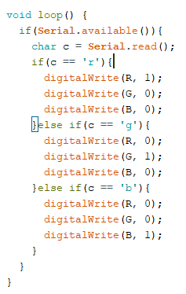
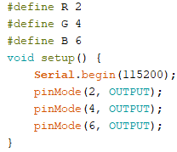
Arduino

Slide 31
References (for parts 1 and 2):
https://www.3blue1brown.com/topics/neural-networks
http://neuralnetworksanddeeplearning.com/chap2.html
https://keras.io/
I actually forgot where I adapted the code from, but it is quite straightforward nevertheless
References (for extra section)
https://www.scaler.com/topics/artificial-intelligence-tutorial/speech-recognition-in-ai/
https://jonathan-hui.medium.com/speech-recognition-phonetics-d761ea1710c0

